Slide 1
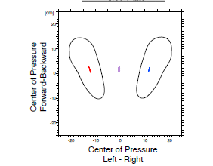
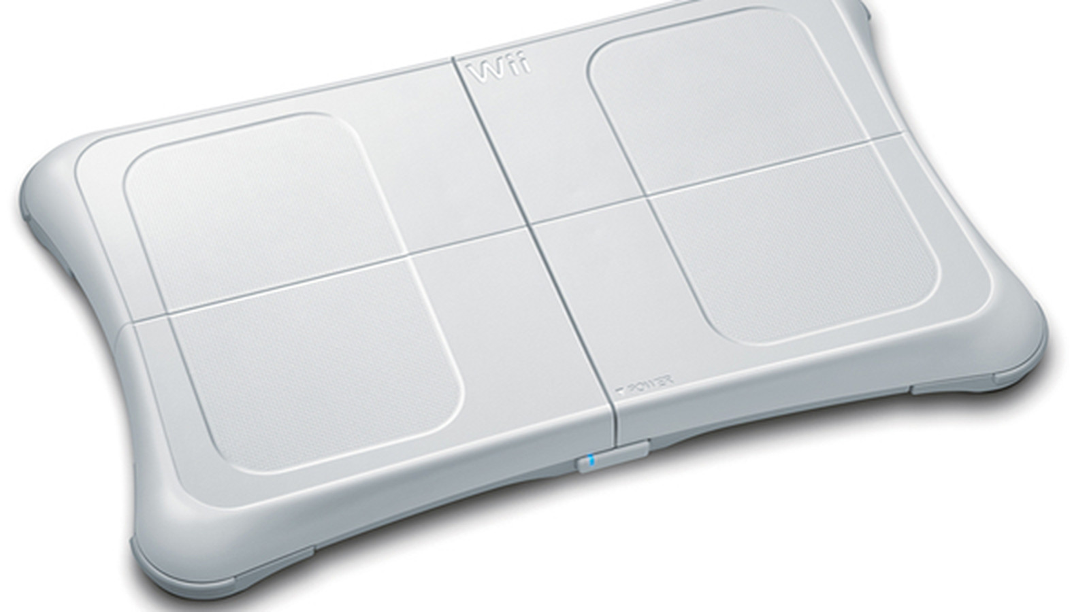
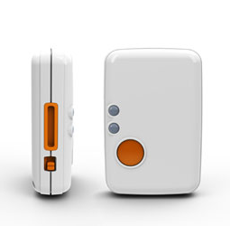
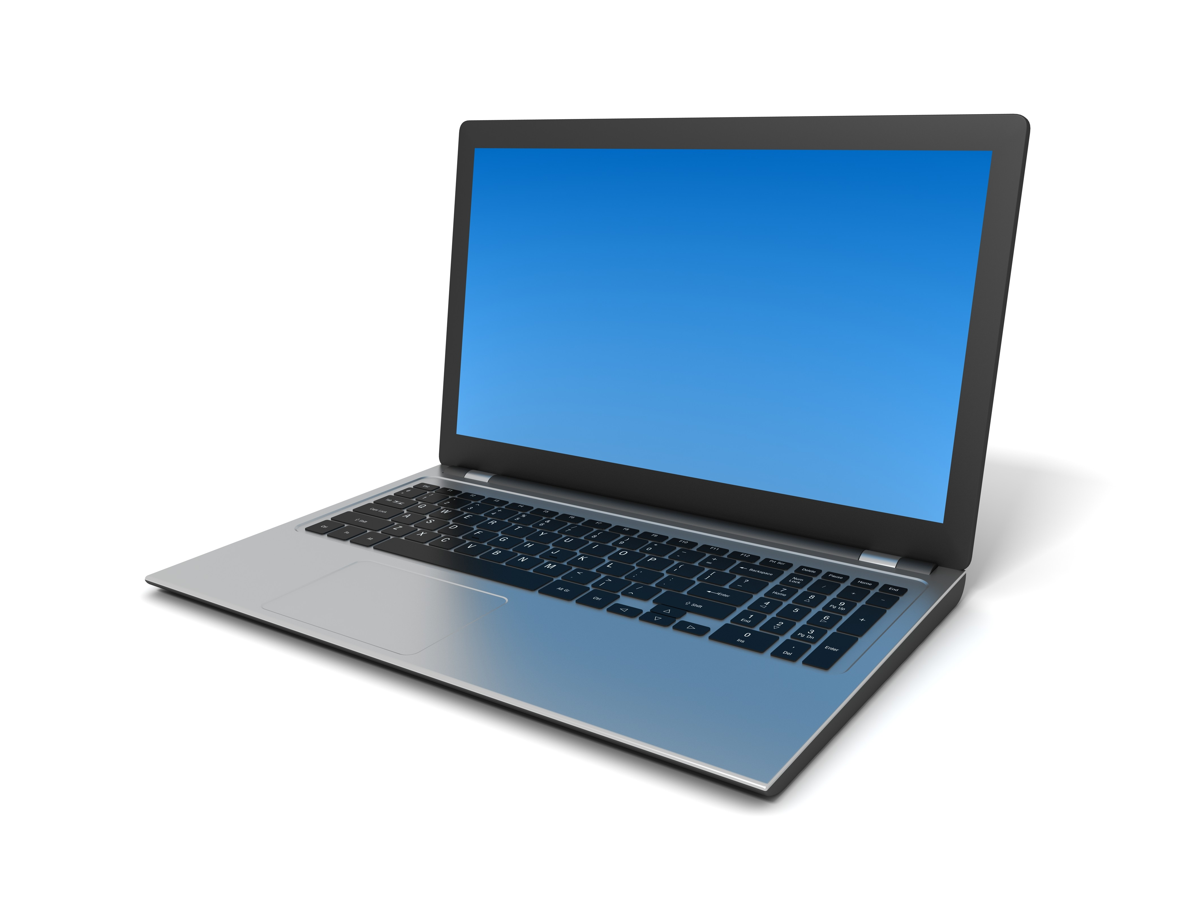

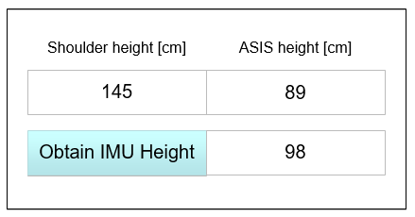
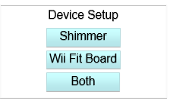
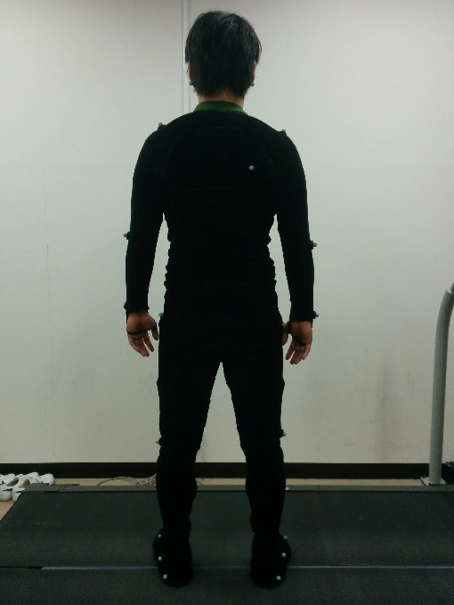

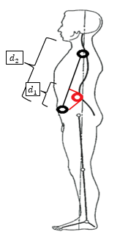
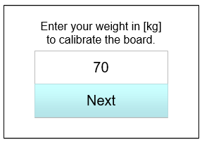
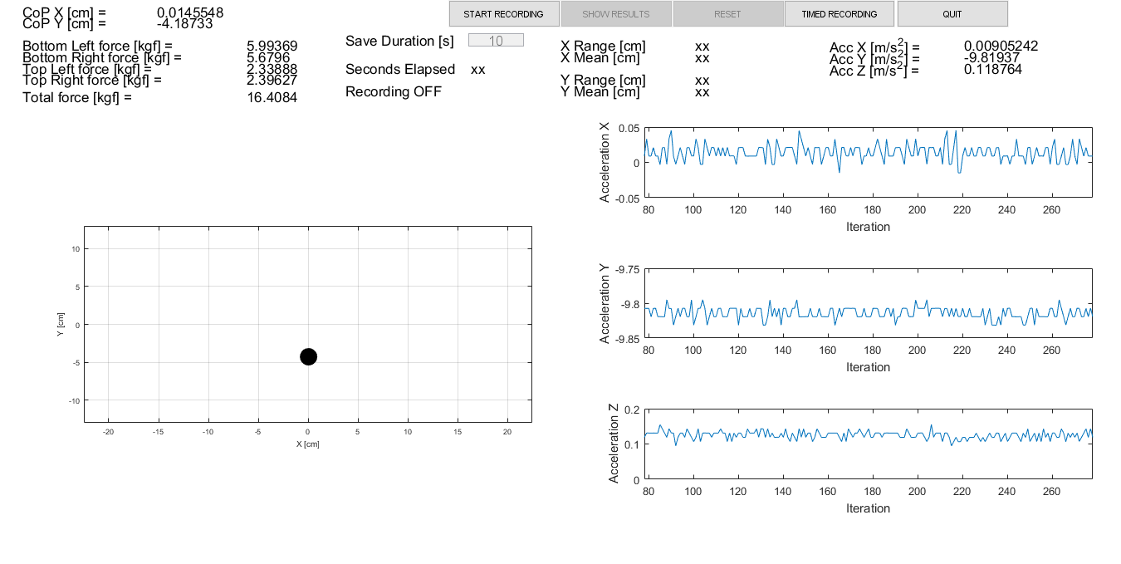
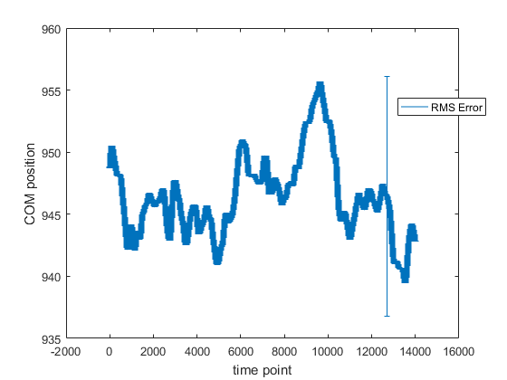
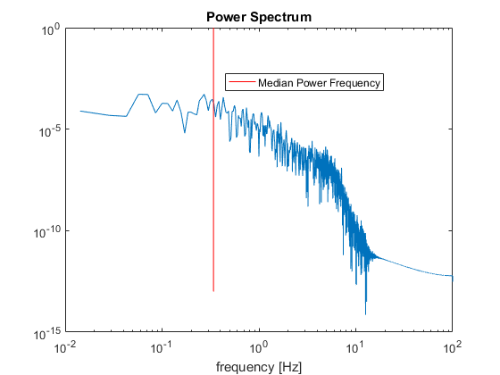
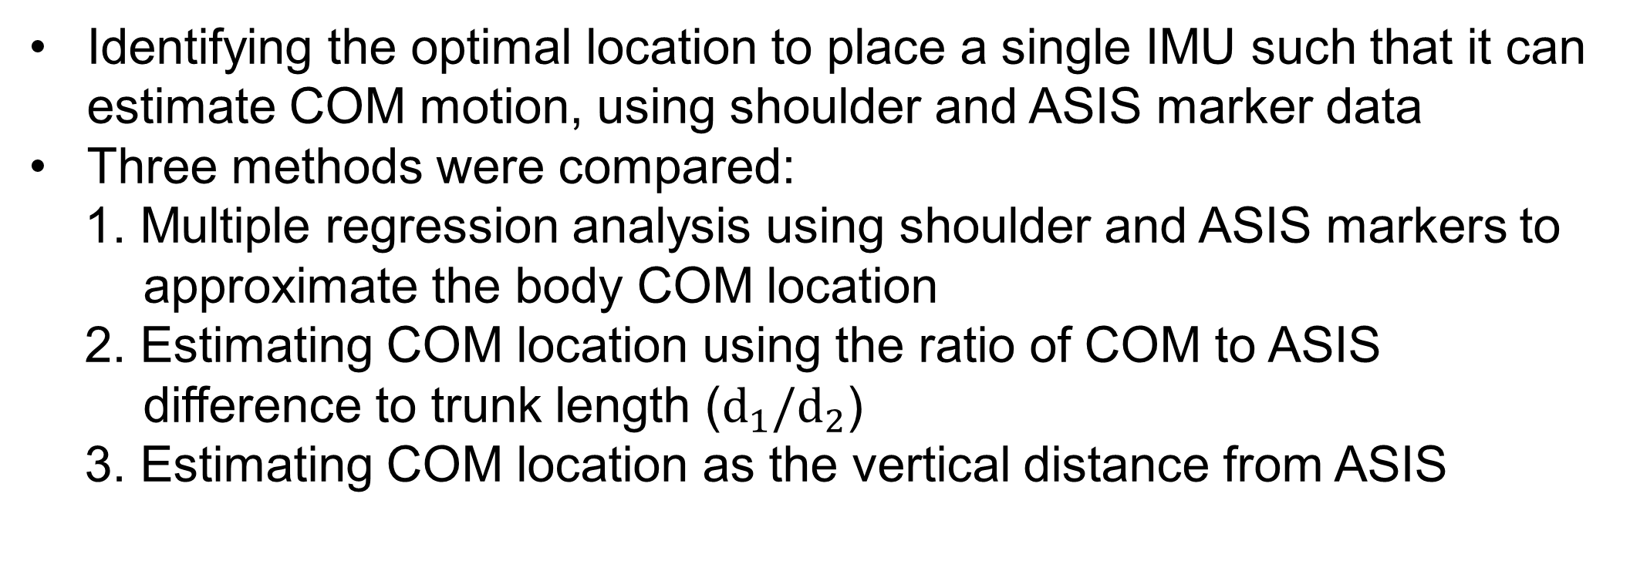
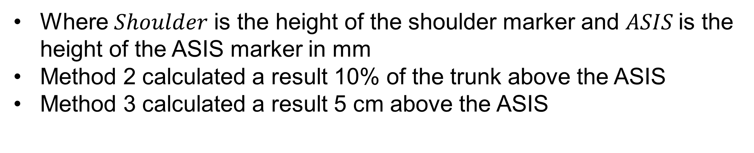
Development of a clinically usable assessment tool for static standing balance
Ray Fang¹, Tony Kung¹, Jaeeun Yoo^{1,3}, Masahiro Shinya², Matija Milosevic², Kei Masani^{1,3}
Rehabilitation Engineering Laboratory | IBBME | University of Toronto
Department of Life Sciences | Graduate School of Arts and Science, University of Tokyo
3) Rehabilitation Engineering Laboratory | Toronto Rehab | UHN
Purpose
A paired t-test showed that COM acceleration in the Anterior-Posterior (AP) direction was the most statistically significant indicator of differences between the three conditions
Method 1 was the most accurate, the multiple regression equation calculating height for IMU location in mm is:
To find the optimal parameter for identifying balance ability, and to find the optimal location for placement of an Inertial Measurement Unit (IMU) for estimating the body’s Centre-of-Mass (COM)
To develop a cost-effective clinical assessment for standing balance
$$COM=908−0.0271×Shoulder−0.954×ASIS+0.000743×Shoulder×ASIS$$
Background
Where $Shoulder$ is the height of the shoulder marker and $ASIS$is the height of the ASIS marker in mm
Method 2 calculated a result 10% of the trunk above the ASIS
Method 3 calculated a result 5 cm above the ASIS
Falls are a serious issue among individuals with impaired motor abilities such as post-stroke patients and the elderly
Assessments using force plates and motion capture during quiet standing can be used to identify risk of fall [1,2]
These methods are not always applicable in a clinical setting due to their setup times and cost
Clinical Assessment Tool
The system integrates a commercially available, low-cost force plate (Wii Balance Board, Nintendo Inc.) and an IMU (Shimmer3, Shimmer Inc.) using MATLAB, Shimmer API, WiiLab library [4], and the CU Wii GUI [5]
Method
14 young, able-bodied participants
Three standing conditions:
1. Standing with eyes open
2. Standing with eyes closed
3. Standing with Stroop test (mental task)
Motion capture, 20 markers, bilateral, Fs = 200 Hz
Force plate, Fs = 1000 Hz
Fig 1-12. COP AP parameters. Fig 13-15. COM AP parameters. p-value < 0.0167
Optimal Placement for IMU
< IMU Location Calculation View >
< Menu View >
Identifying the optimal location to place a single IMU such that it can estimate COM motion, using shoulder and ASIS marker data
Three methods were compared:
1. Multiple regression analysis using shoulder and ASIS markers to approximate the body COM location
2. Estimating COM location using the ratio of COM to ASIS difference to trunk length ($d_{1}/d_{2}$)
3. Estimating COM location as the vertical distance from ASIS
< Calibration View >
< Data Collection View >
Centre-of-Pressure (COP) fluctuation during quiet standing
Shoulder Marker
MoCap markers
COM
Optimal Postural Sway Parameter
ASIS Marker
Identifying the parameter quantifying COM or COP data that shows statistically significant differences between conditions
Time-domain parameters: mean distance, Root-Mean-Square (RMS) distance, mean velocity, total excursions, range, RMS velocity, RMS acceleration, mean amplitude, mean frequency [3]
Frequency-domain parameters: centroidal frequency, frequency dispersion, power frequency, total power [3]
Conclusion
Proposed three methods for the IMU optimal location, that can be easily used by clinicians
An assessment tool has been developed with plans to validate its effectiveness
The next step would be to test the system and compare the recorded results with those of a conventional static standing assessment
Rehabilitation Engineering Laboratory
Institute of Biomaterials and Biomedical Engineering
University of Toronto
Toronto Rehabilitation Institute | University Health Network
Contact: k.masani@utoronto.ca
www.toronto-fes.ca
References
[1] Maki et al. J Gerontol 49(2): M72-84, 1994.
[2] Piirtola et al. Gerontol 52(2): 1-16, 2006.
[3] Prieto et al. IEEE Trans Biomed Eng 43(9): 956-966, 1996
[4] http://netscale.cse.nd.edu/twiki/bin/view/Edu/WiiMote
[5] http://www.colorado.edu/intphys/neuromechanics/cu_wii.html

